Slide 1
Greedy Algorithms

Slide 2
The greedy algorithm
Suppose that a problem can be solved by a sequence of decisions. The greedy method has that each decision is locally optimal. These locally optimal solutions will finally add up to a globally optimal solution.
Only a few optimization problems can be solved by the greedy method.

Slide 3
A Simple Example
Problem: Pick k numbers out of n numbers such that the sum of these k numbers is the largest.
Algorithm:
    FOR i = 1 to k
    Pick out the largest number and
    delete this number from the input.
    ENDFOR

Slide 4
Graph Greedy Coloring
χ(G) ≤ Δ(G) + 1, where χ(G) is the chromatic number of a graph, Δ(G) is the maximum degree in the graph.
Greedy Algorithm:
  Put the vertices of a graph in a sequence
  For each vertex in the sequence, assign it the lowest indexed color not already assigned to adjacent vertices
    Not guaranteed to be optimal for every possible sequence
    Guaranteed optimal for at least one sequence
Different choices of the sequence of vertices will typically produce different colorings of the given graph, so much of the study of greedy colorings has concerned how to find a good ordering. There always exists an ordering that produces an optimal coloring, but although such orderings can be found for many special classes of graphs, they are hard to find in general. Commonly used strategies for vertex ordering involve placing higher-degree vertices earlier than lower-degree vertices.

Slide 5
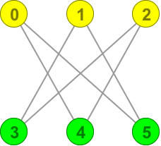
Greedy Coloring Example - 1
Vertex | 0 | 1 | 2 | 3 | 4 | 5
Color | Yellow | Yellow | Yellow | Green | Green | Green

Slide 6
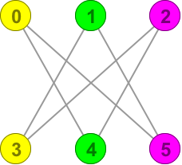
Greedy Coloring Example - 2
Vertex | 0 | 3 | 1 | 4 | 2 | 5
Color | Yellow | Yellow | Green | Green | Purple | Purple

Slide 7
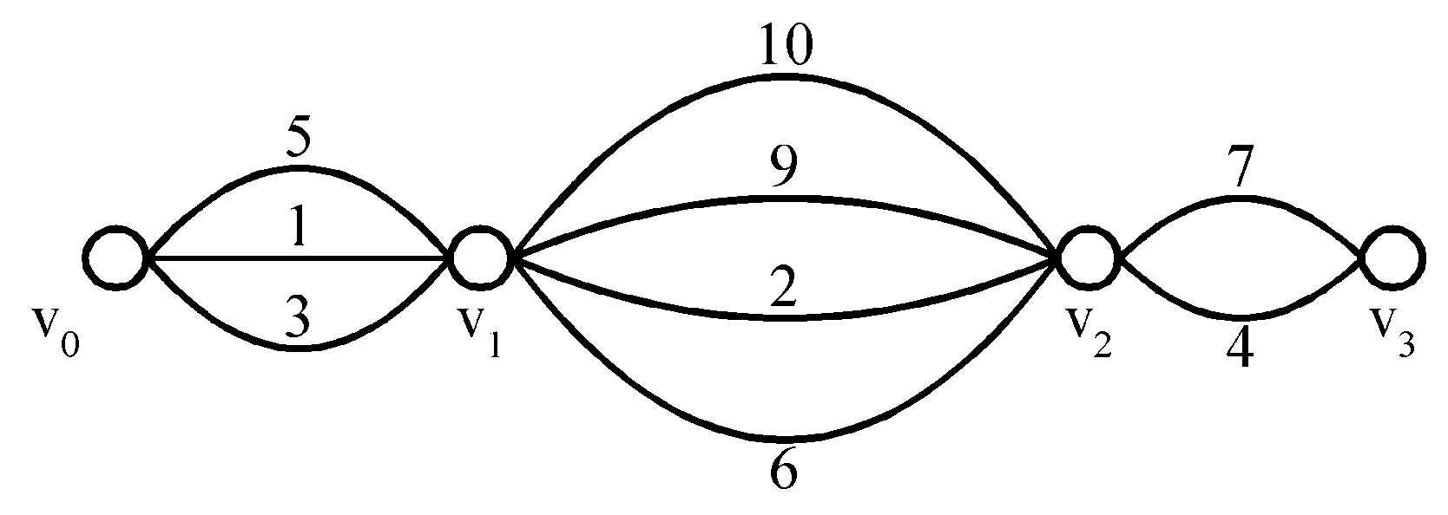
Shortest Paths on a Special Graph
Problem: Find a shortest path from v₀ to v₃.
The greedy method can solve this problem.
The shortest path: 1 + 2 + 4 = 7.

Slide 8
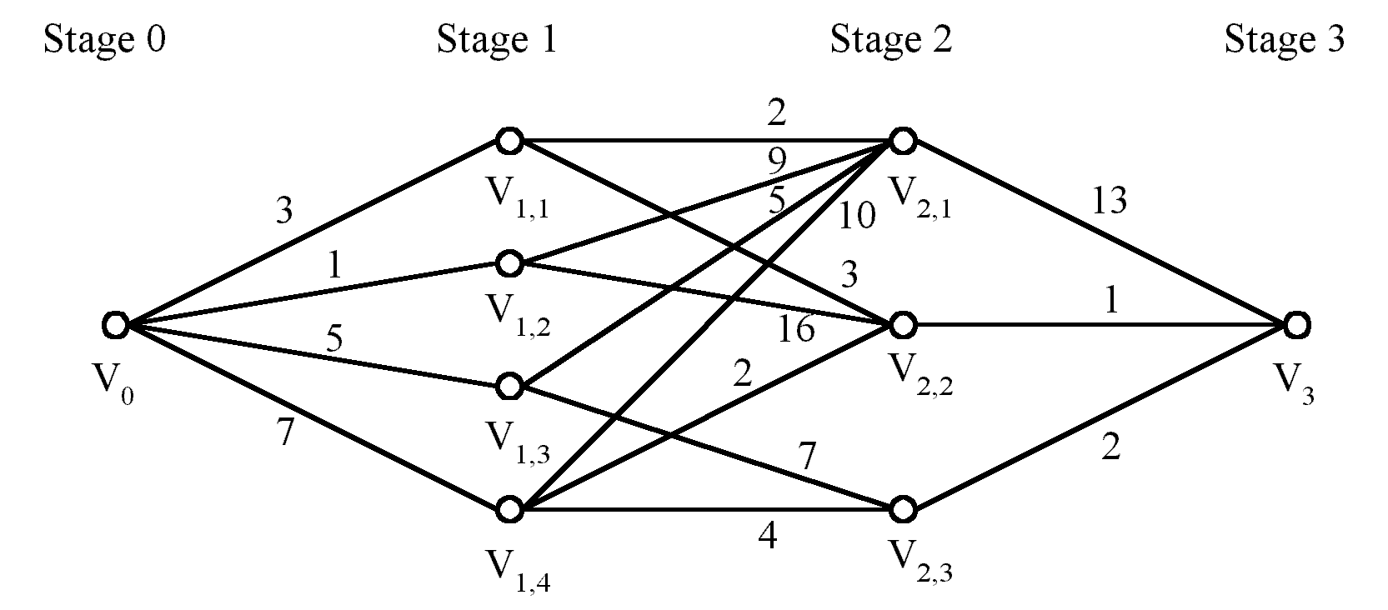
Shortest Paths on a Multi-stage Graph
Problem: Find a shortest path from v₀ to v₃ in a multi-stage graph.
Greedy method: v₀v_{1,2}v_{2,1}v₃ = 23
Optimal: v₀v_{1,1}v_{2,2}v₃ = 7
The greedy method does not work.
This problem can be solved by the dynamic programming method.

Slide 9
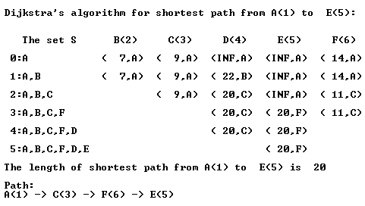
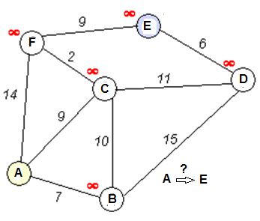
Dijkstra's Algorithm using dynamic programming method
int [][] b = {
{ 0, 7, 9, 99, 99, 14},
{ 7, 0, 10, 15, 99, 99},
{ 9, 10, 0, 11, 99, 2},
{99, 15, 11, 0, 6, 99},
{99, 99, 99, 6, 0, 9},
{14, 99, 2, 99, 9, 0}
};
Dijkstra’s algorithm keeps two sets of vertices:
S Vertices whose shortest paths have already been determined
V-S Remainder
Also
d Best estimates of shortest path to each vertex
p Predecessors for each vertex
Data Structures and Algorithms in Java
<number>/36
Notes:
Image source: http://en.wikipedia.org/wiki/File:Dijksta_Anim.gif

Slide 10
Minimum Spanning Tree (MST)
Suppose we wish to connect all the computers in a new office building using the least amount of cable. We can model this problem using an undirected, weighted graph G whose vertices represent the computers, and whose edges represent all the possible pairs (u,v) of computers, where the weight w(u,v) of edge (u,v) is equal to the amount of cable needed to connect computer u to computer v. Rather than computing a shortest-path tree from some particular vertex v, we are interested instead in finding a tree T that contains all the vertices of G and has the minimum total weight over all such trees. Algorithms for finding such a tree are the focus of this section.

Slide 11
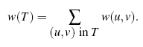
MST - Problem Definition
Given an undirected, weighted graph G, we are interested in finding a tree T that contains all the vertices in G and minimizes the sum
A tree, such as this, that contains every vertex of a connected graph G is said to be a spanning tree, and the problem of computing a spanning tree T with smallest
total weight is known as the minimum spanning tree (or MST) problem. A minimum spanning tree has (n – 1) edges where n is the number of vertices in the given graph.

Slide 12
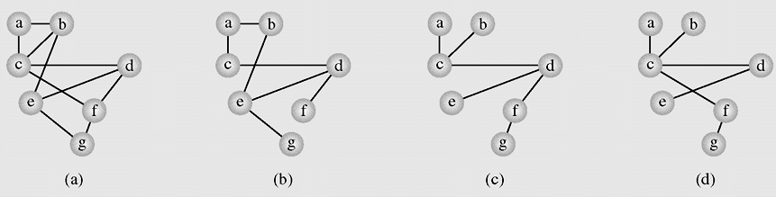
Spanning Tree example
In graph theory, a tree is an undirected, connected graph without simple cycles. A spanning tree is a tree that includes all vertices of the original graph
A graph representing the airline connections between seven cities
Two spanning tree of the graph

Slide 13
Spanning Tree Application
Minimum Spanning Trees (MST) are useful in many applications, for example, finding the shortest total connections for a set of edges.
If we are running cable to the nodes, representing cities, and we wish to minimize cable cost, the MST would be a viable option.
An algorithms will be presented: Prim-Jarnık MST algorithm and Kruskal’s Algorithm.

Slide 14
Kruskal’s MST algorithms
The algorithm is a Greedy Algorithm. The Greedy Choice is to pick the smallest weight edge that does not cause a cycle in the MST constructed so far.
(A popular algorithm, all edges are ordered by weight, each edge is checked to see whether it can be considered part of the tree. It is added to the tree if no cycle arises after its inclusion)
KruskalAlgorithm(weighted connected undirected graph)
tree = null;
edges = sequence of all edges of graph sorted by weight
for (i = 1; i<=|E| and |tree|<|V| - 1; i++)
if e_i from edges does not form a cycle with edges in tree
add e_i to tree

Slide 15
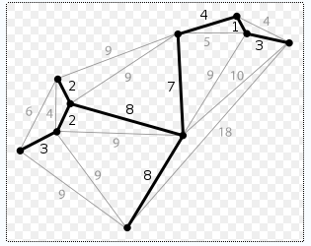
Kruskal Algorithm – demo
(a)
A spanning tree of graph (a) found with Kruskal’s algorithm. The vertices are selected in the following order: 1, 2, 2, 3, 3, 4, 7, 8, 8

Slide 16
The Details for Constructing an MST
How do we check if a cycle is formed when a new edge is added?
If (u, v) ∈ T (being created spanning tree) and there is a path between them in T, then we cannot add the edge (u, v) to T because path + new edge will form a cycle.

Slide 17
Time Complexity of Kruskal’s Algorithm
Time complexity:
O(n²logn), where n = |V|.

Slide 18
Prim’s Algorithm for Finding an MST
Step 1: x ∈ V, Let A = {x}, B = V - {x}.
Step 2: Select (u, v) ∈ E, u ∈ A, v ∈ B such that (u, v) has the smallest weight between A and B.
Step 3: Put (u, v) into the tree. A = A ∪ {v}, B = B - {v}
Step 4: If B = ∅, stop; otherwise, go to Step 2.
Time complexity : O(n²), n = |V|.

Slide 19
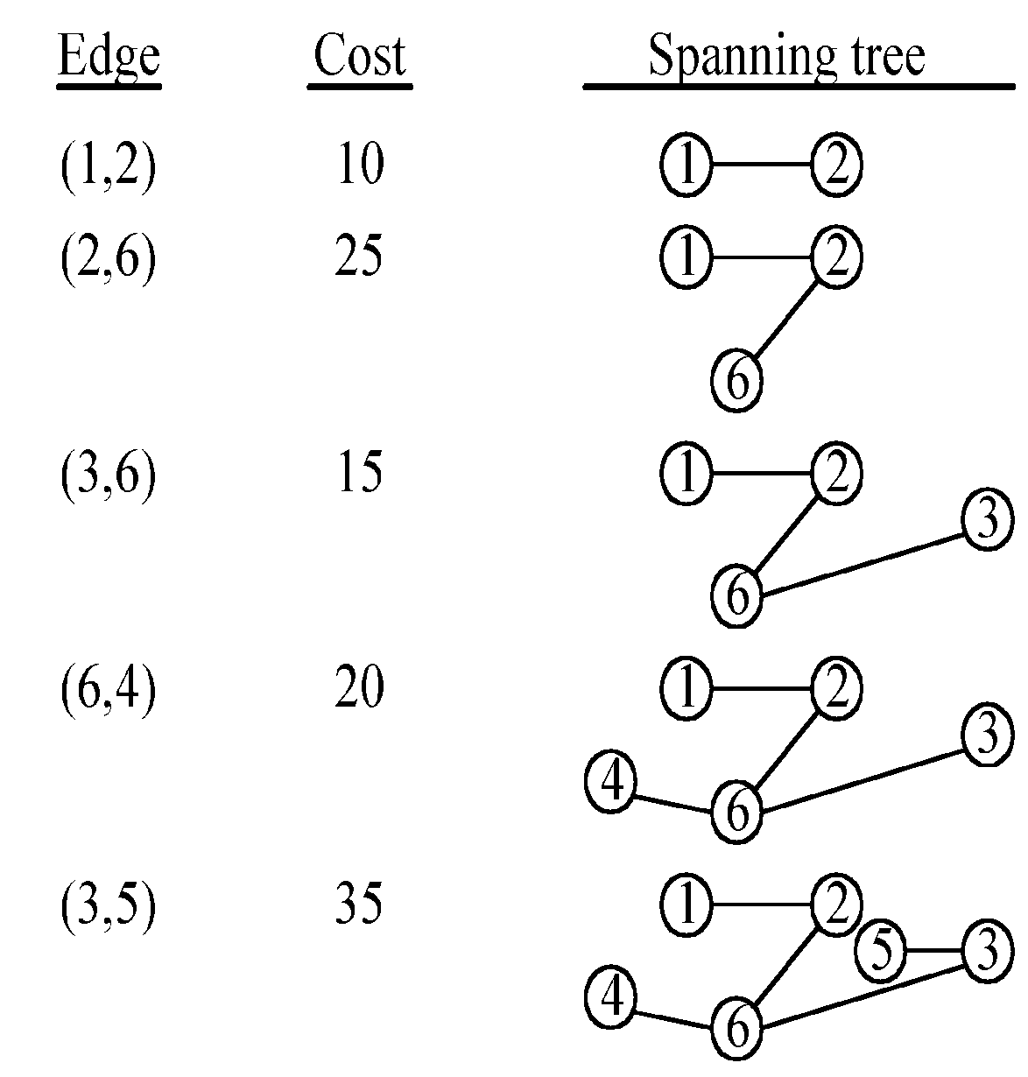
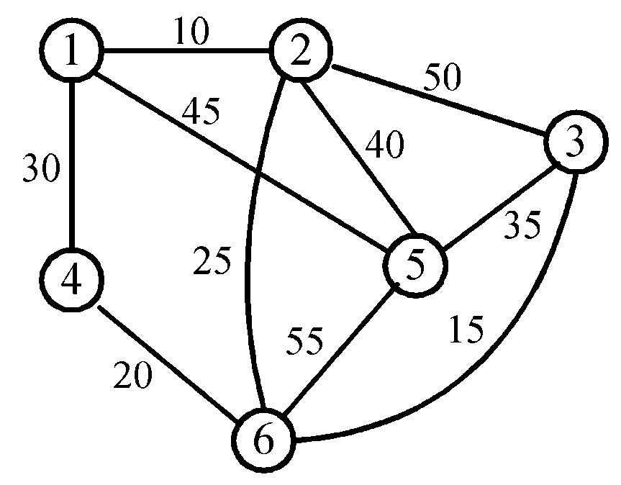
An Example for Prim’s Algorithm
3 -<number>

Slide 20
Huffman codes
In telecommunication, how do we represent a set of messages, each with an access frequency, by a sequence of 0’s and 1’s?
To minimize the transmission and decoding costs, we may use short strings to represent more frequently used messages.

Slide 21

Huffman Coding algorithm
Main idea: Encode high probability symbols with fewer bits
Make a leaf node for each code symbol
  Add the generation probability or the frequency of each symbol to the leaf node (arrange them from left to right in descending order by probability)
Take the two leaf nodes with the smallest probability and connect them into a new node
  Add 1 or 0 to each of the two branches
  The probability of the new node is the sum of the probabilities of the two connecting nodes
If there is only one node left, the code construction is completed. If not, go back to (2)

Slide 22
Huffman Coding example - 1
Character (or symbol) frequencies
  A : 20% (.20) e.g., A occurs 20 times in a 100 character document, 1000 times in a 5000 character document, etc.
  B : 9% (.09)
  C : 15% (.15)
  D : 11% (.11)
  E : 40% (.40)
  F : 5% (.05)
Also works if you use character counts
Must know frequency of every character in the document

Slide 23
Huffman Coding example - 2
Symbols and their associated frequencies.
Now we combine the two least common symbols (those with the smallest frequencies) to make a new symbol string and corresponding frequency.
E
.40
A
.20
C
.15
D
.11
B
.09
F
.05

Slide 24
Huffman Coding example - 3
Heres the result of combining symbols once.
Now repeat until youve combined all the symbols into a single string.
E
.40
A
.20
C
.15
BF
.14
D
.11
B
.09
F
.05

Slide 25
Huffman Coding example - 4
Heres the result of combining symbols once.
Now repeat until youve combined all the symbols into a single string.
E
.40
BFD
.25
A
.20
C
.15
BF
.14
D
.11
B
.09
F
.05

Slide 26
Huffman Coding example - 5
Heres the result of combining symbols once.
Now repeat until youve combined all the symbols into a single string.
E
.40
AC
.35
BFD
.25
A
.20
C
.15
BF
.14
D
.11
B
.09
F
.05

Slide 27
Huffman Coding example - 6
BFDAC
.60
E
.40
AC
.35
BFD
.25
A
.20
C
.15
BF
.14
D
.11
B
.09
F
.05

Slide 28
Huffman Coding example - 7
Codes: (reading from top to bottom)
  A: 000
  B: 0100
  C: 001
  D: 011
  E: 1
  F: 0101
Note
None are prefixes of another
BFDACE
1.00
0
1
BFDAC
.60
E
.40
0
1
AC
.35
BFD
.25
0
1
0
1
A
.20
C
.15
BF
.14
D
.11
0
1
B
.09
F
.05

Slide 29
Huffman Coding example - 8
Character | Code | Length | Probability
A | 000 | 3 | .20
B | 0100 | 4 | .09
C | 001 | 3 | .15
D | 011 | 3 | .11
E | 1 | 1 | .40
F | 0101 | 4 | .05
Average Code Length:
(3 x 0.20) + (4 x 0.09) + (3 x 0.15) + (3 x 0.11) + (1 x 0.40) + (4 x 0.05)
= 2.34 digits

Slide 30
Huffman Coding notes
There is no unique Huffman code
  Assigning 0 and 1 to the branches is arbitrary
  If there are more nodes with the same probability, it doesnt matter how they are connected.
  However, if the probability in each node is unique and the left nodes probability is always larger than the rights one, then the code is unique.
Every Huffman code has the same average code length!

Slide 31
Some important statements
in Huffman Encoding program
static final int R = 256;
// tabulate frequency counts
int[] freq = new int[R]; = new int[R];
for (int i = 0; i < input.length; i++) freq[input[i]]++;
// build Huffman tree
Node root = buildTree(freq);
// build code table
String [] st = new String[R]; buildCode(st, root, "");
// make a codewords table from symbols and their encodings
void buildCode(String[] st, Node x, String s)
{ if (!x.isLeaf())
{buildCode(st, x.left, s + 0); buildCode(st, x.right, s + 1); }
else
{st[x.ch] = s; }
}

Slide 32
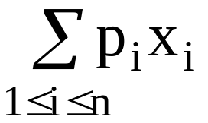
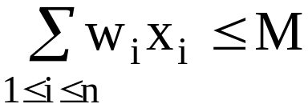
The knapsack Problem
n objects, each with a weight w_{i} > 0
a profit p_{i} > 0
capacity of knapsack: M
Maximize
Subject to
0 ≤ x_{i} ≤ 1, 1 ≤ i ≤ n
3 -<number>

Slide 33
The knapsack problem is different from the 0/1 knapsack problem. In the 0/1 knapsack problem, x_{i} is either 0 or 1 while in the knapsack problem, 0 ≤ x_{i} ≤ 1.

Slide 34
The knapsack algorithm
The greedy algorithm:
Step 1: Sort p_{i}/w_{i} into nonincreasing order.
Step 2: Put the objects into the knapsack according
to the sorted sequence as far as possible.
e.g.
  n = 3, M = 20, (p₁, p₂, p₃) = (25, 24, 15)
  (w₁, w₂, w₃) = (18, 15, 10)
  Sol: p₁/w₁ = 25/18 = 1.32
  p₂/w₂ = 24/15 = 1.6
  p₃/w₃ = 15/10 = 1.5
  Optimal solution: x₁ = 0, x₂ = 1, x₃ = 1/2

